Slide 1


Slide 2

Madeleine Landrieu
Dean of Loyola University College of Law

Slide 3
One Church, One Child
YouTube Video
https://www.youtube.com/watch?v=r5LefWipCYY

Slide 4

First Lady Donna Edwards

Slide 5

Kim Carver
President of the Board

Slide 6
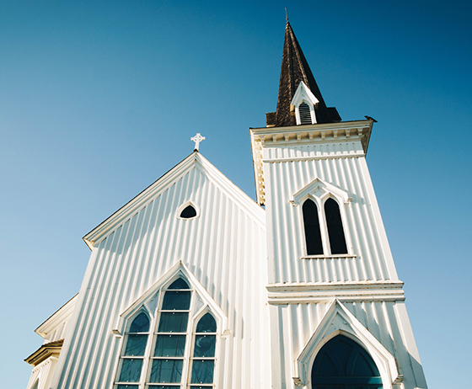
What does a foster care/adoption ministry look like in my church?

Slide 7


Slide 8
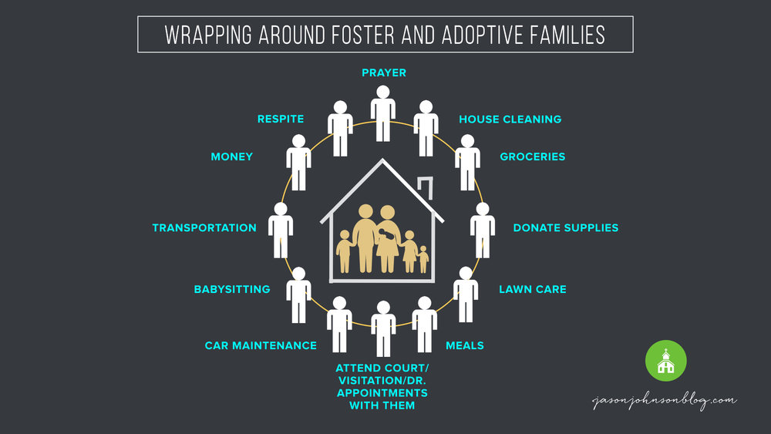

Slide 9
Wading in
Shallow
Provide Meals, Pray & Fast, Supplies, Foster Family Date Nights & other serve projects
Middle
Respite teams, certified babysitting, adoption grant fund, transportation
Deep
Foster, Adopt, Family preservation, mentoring, Open Table

Slide 10
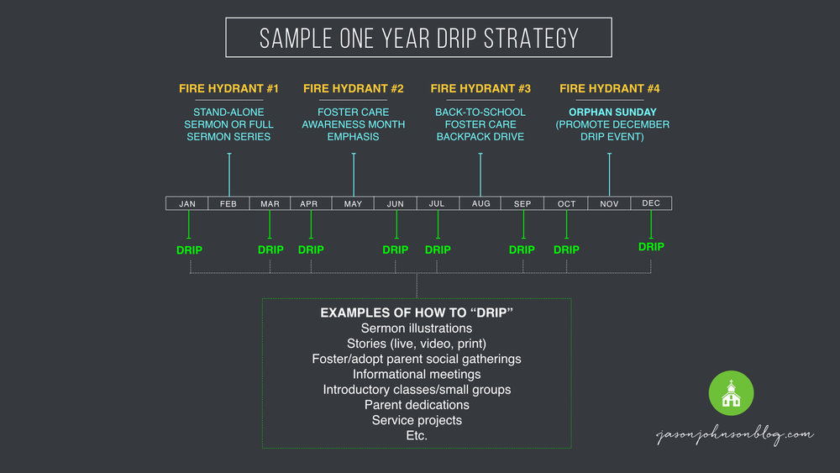

Slide 11
At my church, some of us are going to bring children into our homes.
The rest of us are going to find ways to serve & support them.

Slide 12

Marketa Garner Walters
Secretary

Slide 13
